Slide 1
Run Levels

Slide 2
Introduction to run level
A runlevel is one of the modes that an operating system will run in. Each runlevel has a certain number of services stopped or started, giving the user control over the behavior of the machine. Conventionally, seven runlevels exist, numbered from zero to six.
After the Linux kernel has booted, the init program reads the /etc/inittab file to determine the behavior for each runlevel. Unless the user specifies another value as a kernel boot parameter, the system will attempt to enter (start) the default runlevel.

Slide 3
Run levels
7 run levels: 0 to 6
run level 0 : halted state
run level 1 : single user (CLI). Also called system maintenance mode
run level 2 : multiple user without network access(CLI)
run level 3 :multiple user with network access CLI
run level 4 : unused. can be used to define your own customized
run level 5 : GUI
run level 6 : reboot

Slide 4
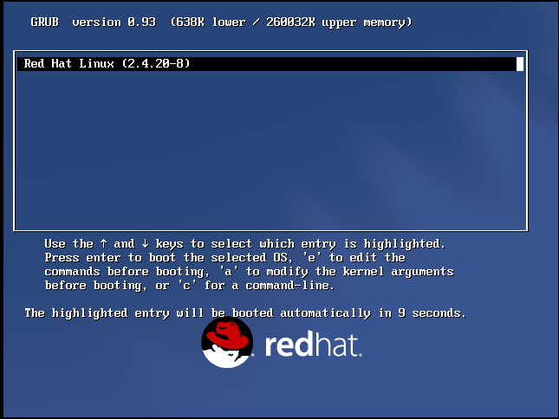

Slide 5
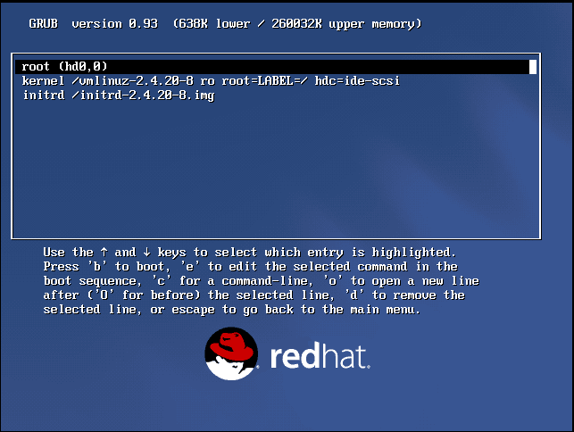

Slide 6
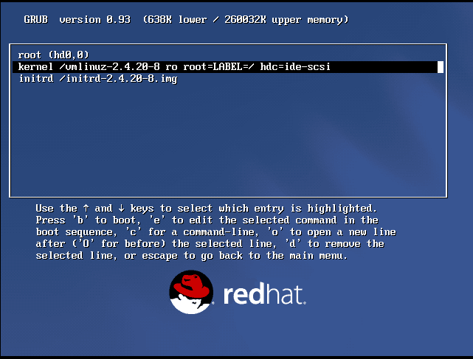

Slide 7
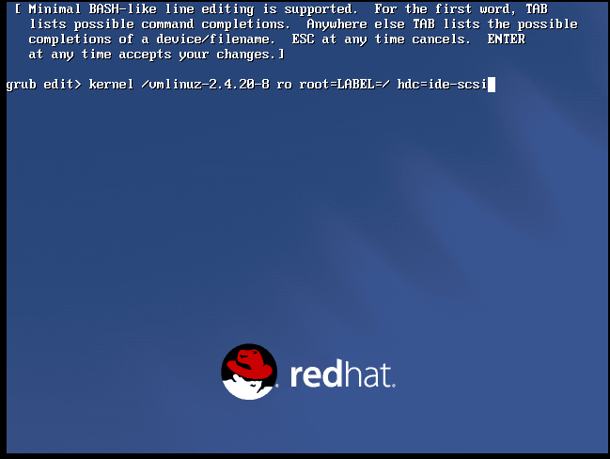

Slide 8
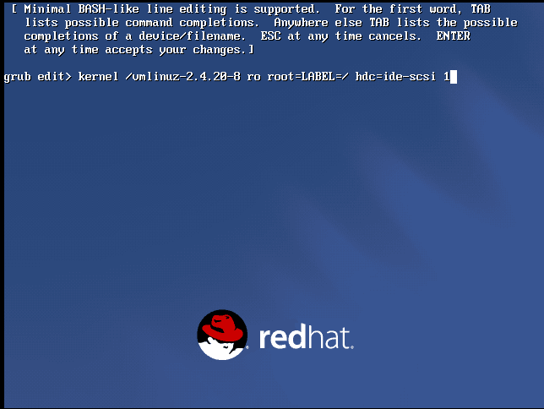

Slide 9
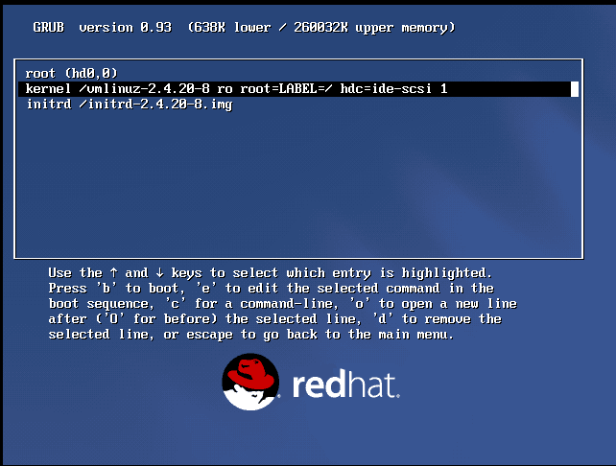

Slide 10
